Slide 1





Dook Travels
Premier DMC for CIS Countries & Turkey
Pioneering Journeys. Unmatched Expertise. Shared Success.
B2B & Partner Presentation
July 2025
www.dooktravels.com

Slide 2







About Dook Travels: The CIS Pioneers
We didn't just enter the market—we created it. Since 2010, Dook Travels has been the trailblazer introducing CIS destinations like Uzbekistan and Russia to the Indian & South Asian market. Our journey has been defined by innovation, trust, and a commitment to providing unparalleled travel experiences.
5 Lakh+
10,000+
500+
Happy travelers have explored with us, experiencing the magic of the CIS region.
Travel agents trust Dook Travels to deliver exceptional value and service.
Corporate clients rely on us for their incentive tours and business travel needs.
Our Mission
To provide unparalleled value, seamless execution, and authentic travel experiences across our specialized destinations.
2/12

Slide 3







Our Journey of Innovation & Growth
From humble beginnings to becoming the undisputed leader in CIS & Turkey tourism, Dook Travels has evolved through decades of innovation, expansion, and technological advancement.
2010-2011
2012-2016
2017-2020
2023 & Beyond
The Beginning
Market Expansion
Service Diversification
Tech & New Horizons
Pioneered group tours to Uzbekistan & Russia, opening a new frontier for Indian travelers.
Systematically expanded our footprint across the CIS, adding Kazakhstan, Georgia, Armenia, and Azerbaijan.
Strengthened our MICE & Corporate travel division, becoming the go-to expert for large-scale incentive tours.
Launched our state-of-the-art B2B booking portal and expanded our portfolio to include Turkey and key Eastern European destinations.
3/12

Slide 4











The Dook Advantage: Why We Lead
Dook Travels establishes its market leadership through four key pillars that deliver superior value and exceptional service to our partners and clients.
Pioneering Expertise
Robust On-Ground Infrastructure
14+ years of specialized, on-the-ground experience in a region others are just discovering.
Fully-owned offices, transport fleets, and even our own Indian restaurants in key destinations.
Indian-Centric Solutions
End-to-End Service Ecosystem
Deep understanding of the needs of the Indian traveler—from cuisine to comfort—and deliver solutions no one else can.
A single, reliable partner for everything: FIT, Group Tours, MICE, Visas, and more.
4/12

Slide 5



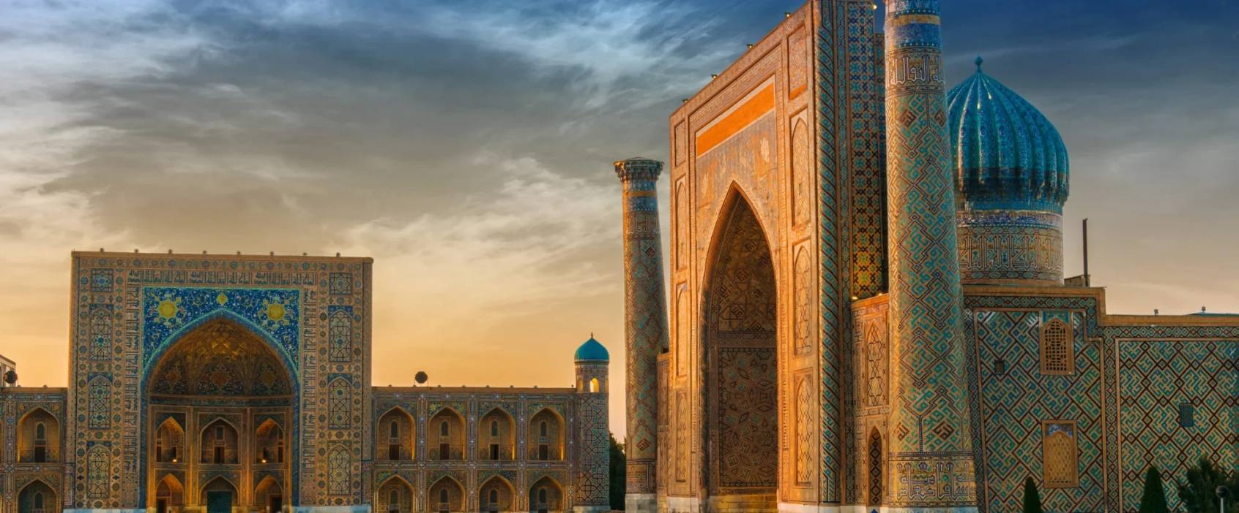



Unmatched Expertise in the CIS & Turkey
Destination mastery is in our DNA. For over a decade, we've been pioneering journeys across the CIS and Turkey, developing specialized knowledge and innovative approaches that set us apart.
Product Innovation
We constantly "invent" new travel circuits and experiences, moving beyond standard itineraries to offer authentic, memorable journeys that showcase the unique aspects of each destination.
Logistical Prowess
We specialize in complex, multi-country tours, ensuring a seamless and hassle-free experience for groups and FITs alike. Our expertise lies in coordinating elaborate itineraries across borders with precision.
Registan Square, Samarkand - One of our many mastered destinations
Deep Local Knowledge
Our teams possess intimate knowledge of the culture, logistics, and hidden gems of every destination we operate in. This allows us to provide authentic experiences that others miss.
5/12

Slide 6
















Our On-Ground Infrastructure: Your Assurance of Quality
We're not just present—we're invested. Dook Travels has established robust on-the-ground infrastructure to ensure seamless execution of every travel program in the CIS region.
Partner Relationships
Physical Presence
Indian Restaurants
Fully-staffed offices in 9+ countries across the CIS region, including:
We are one of the only DMCs to operate our own chain of Indian restaurants in key CIS locations, solving the number one concern for Indian travelers.
Long-standing, exclusive relationships with the best hotels and transport providers, ensuring:
Uzbekistan
Kazakhstan
Georgia
Azerbaijan
More
Priority service
A taste of home, guaranteed
Competitive rates for our partners
For real-time, on-the-ground support.
Your assurance of quality: Dook Travels' robust infrastructure provides a level of support and service that other DMCs simply cannot match.
6/12

Slide 7







Comprehensive Solutions for Every Travel Need
Your one-stop solution for all travel requirements, tailored to each segment's unique needs.
For Travel Agents
For Corporates
For Travelers
Largest portfolio of fixed departures
All-inclusive holiday packages
Customizable FITs
Value-driven pricing
Instant confirmations
Authentic Indian meals
Key Benefit: Streamline operations with our powerful B2B booking portal
Key Benefit: Worry-free travel with premium hotels and flights
Proven expertise in incentive tours
Offsites and conferences
Key Benefit: Flawless execution for 500+ leading companies
7/12

Slide 8



















The Power of Partnership: Our B2B & Corporate Ecosystem
At Dook Travels, we believe in building win-win partnerships that drive growth for both parties. Our integrated ecosystem provides comprehensive support for travel agents and tailored solutions for corporate clients.
Empowering Our Agent Network
The Trusted Choice for Corporate Travel
Innovative B2B Portal
Instantly book flights, hotels, meals, and tours with live inventory and dynamic pricing.
Tailored MICE Solutions
End-to-end MICE solutions tailored to your company's objectives and budget.
Dedicated Support
A dedicated account manager for training, support, and query resolution.
Large-Scale Events
Expertise in handling incentive tours, conferences, and company offsites with precision and creativity.
Best-in-Market Value
Unbeatable rates and commissions that help you grow your business.
Seamless Global Coordination
A single, reliable point of contact for seamless global coordination of all your travel needs.
We Succeed When Our Partners Succeed
8/12

Slide 9














The Dook Difference: A Clear Comparison
Why settle for a follower? Partner with the undisputed market leader. Dook Travels stands apart with unique advantages that others simply cannot match.
Feature
Dook Travels
Other DMCs
Own Indian Restaurants in CIS
Yes
No / Rarely
Pioneer in Indian Market
Since 2010
Follower
Comprehensive B2B Tech Platform
Yes
Limited / None
Specialized Indian Market Focus
Core DNA
General
On-Ground Offices in 9+ Countries
Yes
Limited Presence
Proven MICE & Corporate Expertise
Yes
Variable
The choice is clear: When you partner with Dook Travels, you gain advantages that simply aren't available elsewhere in the market.
9/12

Slide 10












A Legacy of Trust & Success in Numbers
Our numbers don't just tell a story—they prove our commitment to delivering exceptional travel experiences and building lasting partnerships.
500,000+
10,000+
500+
250+
14+
Happy Travelers
Travel Agent Partners
Corporate Clients Served
Dedicated Professionals
Years of Market Leadership
These numbers represent more than just statistics—they represent thousands of successful journeys, meaningful partnerships, and a legacy of trust built on years of expertise in the CIS region.
10/12

Slide 11













Let's Partner for Success
We Succeed When Our Partners Succeed. Join forces with Dook Travels for mutual growth and unforgettable travel experiences.
For Travel Agents
For Corporates
For Travelers
Join our exclusive network to unlock the most comprehensive CIS & Turkey product portfolio and drive your business growth.
Challenge us to design your next unforgettable incentive trip, conference, or company offsite.
Book your next adventure with the confidence that you are traveling with the region's most trusted experts.
Design Your Event
Book Your Adventure
Join Our Network
partners@dooktravels.com | www.dooktravels.com
11/12

Slide 12












Contact & Connect
Thank you for your interest in Dook Travels. We look forward to connecting with you and discussing how we can work together to create exceptional travel experiences.
Website
Follow Our Journey
www.dooktravels.com
Facebook
Instagram
Email Us
For Partnerships & MICE:partners@dooktravels.com
For General Inquiries:info@dooktravels.com
Ready to Partner with the Best?
Join our exclusive network or request a quote for your next business travel program.
Phone
Unparalleled expertise in CIS & Turkey
First-mover advantage since 2010
[Your Primary Contact Number]
Indian-centric solutions
Robust on-ground infrastructure
12/12

